Slide 1
Data Structure & Algorithms
Presented by:
DEBENDU KUMAR

Slide 2
I
Data Structures & Algorithms
Data structures is a method of organizing data in a virtual system. Think of sequences of numbers of tables of data, these both are well-defined data structures.
An algorithm is a sequence of steps executed by a computer that takes an input and transform it into a target output.

Slide 3
Types of Data Structures
Data Structures
Linear
Non-Linear
Array
Linked List
Stack
Queue
Graph
Tree
Notes:
Democratisation (means making something accessible and available to a wider range of people) and decentralisation (refers to distribution of power to authority away from a central authority or governing body to a local or regional authorities or communities)
Inclusivity and access for sellers especially small and medium enterprise as well as local businesses

Slide 4
Analysis of Algorithms
An algorithm is a set of instruction to perform a task or to sole a given problem
There are several different algorithms to solve a given problem
Analysis of algorithm deals in finding best algorithm which runs fast and takes in less memory
To determine the efficiently of algorithm we check
Time complexity
Space complexity
public Integer findSum(Integer n) { int sum = 0; for(int i = 1; i <= n; i++) { sum = sum + i; } return sum; }
public Integer findSum(Integer n) { return n * (n + 1) / 2; }
Notes:
network grievance – refers to a situation where a participant in the network experiences an issues or dispute related to the functioning of the network. To address network grievances blockchain communities often establish governance framework or dispute resolution mechanisms, such as voting systems or arbitration protocols, to help participants resolve issues and reach consensus on important decisions affecting the network.

Slide 5
Time Complexity
The amount of time taken by algorithm to run
The input processes by an algorithm helps in determining the time complexity

Slide 6
Space Complexity
The amount of memory or space taken by the algorithm to run
The memory required to process the input by an algorithm helps in determining the space complexity

Slide 7
Asymptotic Analysis
Asymptotic analysis of an algorithm refers to defining the mathematical foundation of its run-time performance. Using the asymptotic analysis, we can very well conclude the best case, average case and worst case scenario of an algorithm.
Using asymptotic analysis we don’t measure actual running time of algorithm.
It helps in determining how time and space taken by algorithm increases with input size

Slide 8
Asymptotic Notations
Asymptotic notations are the mathematical tools used to describe the running time of an algorithm in terms of input size .
Asymptotic notations help us in determining
Omega Ω (Best Case)
lower bound of algorithm’s running time, i.e best amount of time an algorithm can take to complete.
Example, if we say certain algorithm takes 100 secs to complete the operation, so that 100 secs is the lower bound of that algorithm.
Big O (Worst Case)
It is the upper bound of an algorithm running time, it means for any given input longest amount of time an algorithm can take to complete.
Example, if we say certain algorithm takes 100 secs as longest amount of time, so 100 secs will be upper bound of that algorithm. The algorithm can take less than 100 secs but it will not take more than 100 secs.
Theta Θ (Average Case)
This notation express both upper and lower bound of an algorithm running time, i.e for any given input this notation determines average amount of time an algorithm can take to complete
Example, if we run certain algorithm and it takes 100 secs for first run 120 secs for second run, 110 for third run and so on. So, theta notation gives an average of running time of that algorithm.

Slide 9
Big O(O) Notation - Rules
It’s a single processor
It performs sequential execution of statements
Assignment operation takes 1 unit of time
Return statement takes in 1 unit of time
Arithmetical operation takes 1 unit of time
Logical operation takes 1 unit of time
Other small / single operation takes 1 unit of time
Drop lower order terms
Drop constant multipliers

Slide 10
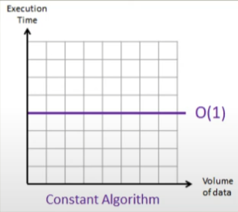
Calculating Time Complexity of Constant Algorithm
public Integer findSum(Integer n) { return n * (n + 1) / 2; }
Line no. | Operations | Unit time
2 | 1+1+1+1+1+1 | 6
Accessing value n
N+1
(N+1)/2
Accessing value n
N * value of (n+1)/2;
Return
Time Complexity = O(1)

Slide 11
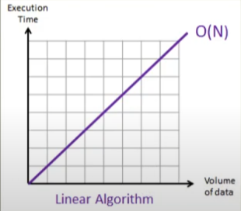
Calculating Time Complexity of Linear Algorithm
Line no. | Operations | Unit time
2 | 1 | 1
3 | 1 + 3(n+1) + 3n | 6n + 4
4 | 4(1 + 1 + 1 + 1) | 4n
5 | 1 + 1 | 2
public Integer findSum02(Integer n) { int sum = 0; for(int i = 1; i <= n; i++) { sum = sum + i; } return sum; }
T = 1 + 6n + 4 + 4n + 2
T = 10n + 7
T = n
Time Complexity = O(n)

Slide 12
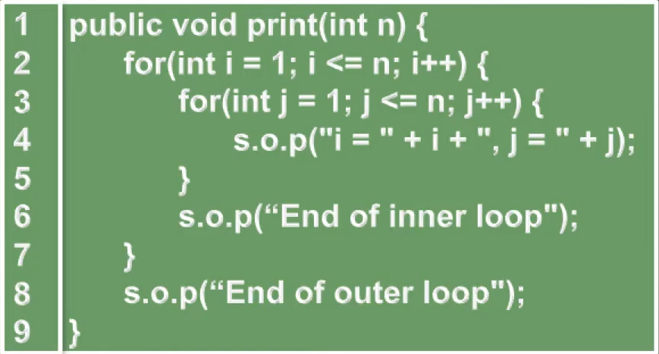
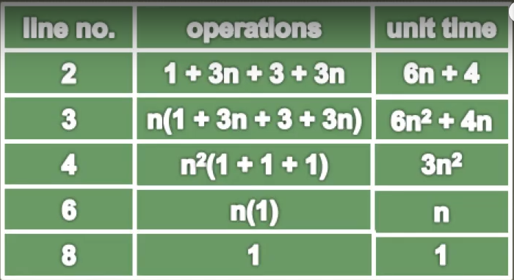
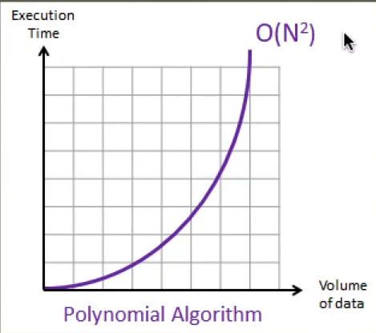
Calculating Time Complexity of Polynomial Algorithm
T = 6n + 4 + 6² + 4n + 3n² + n + 1
Time Complexity = O(n²)
If there are 3 nested for loop time complexity will be O(n³), so which means the order of n will increase as you add nested loops

Slide 13
How to measure the code using Big O
No | Description | Complexity
Rule 1 | Any assignment statement and if statements that are executed once regardless of the size of the problem | O(1)
Rule 2 | A simple “for” loop from 0 to n (with no internal loops) | O(n)
Rule 3 | A nested loop of the same type takes quadratic time complexity | O(n²)
Rule 4 | A loop in which the controlling parameter is divided by two at each step | O(log n)
Rule 5 | When dealing with multiple statement just add them up

Slide 14
Array List
ArrayList uses array is a dynamic resizable data structure that is part of Java collection framework, it can grow and shrink in size as the element is added and removed
ArrayList internally uses an array to store its elements
Difference between Array and ArrayList
Arrays are of fixed size whereas ArrayList is dynamic
Type safe - In case of Array we must specify the type in case of ArrayList its not mandatory to specify the type
Performance - ArrayList are slower than Arrays due to overhead of resizing and additional methods

Slide 15
Singly Linked List

Slide 16

Thank you
www.zestic.in
Contact us: www.zestic.in/contact-us
All information present here is the exclusive property of Zestic IT Solutions (Zestic) and is subject to change without notice. Any unauthorized use of the content appearing here may violate copyright, trademark and other applicable laws.

